Slide 1

Industrial Training
on
“Full-Stack Web Development”
Presented By:
Sanskrati Jain
21EJCCS805
CSE/5th Sem/Section D
Submitted To:
Mr. Neeraj Prakash Shrivastava
Class Coordinator, CSE

Slide 2
VISION AND MISSION OF INSTITUTE
Vision of the Institute
To become a renowned Centre of outcome based learning, and work towards academic, professional, cultural and social enrichment of the lives of individuals and communities.
Mission of the Institute
Focus on evaluation of learning outcomes and motivate students to inculcate research aptitude by project based learning.
Identify, based on informed perception of Indian, regional and global needs, areas of focus and provide platform to gain knowledge and solutions.
Offer opportunities for interaction between academia and industry.
Develop human potential to its fullest extent so that intellectually capable and imaginatively gifted leaders can emerge in a range of professions.

Slide 3
VISION AND MISSION OF DEPARTMENT
Vision of the Department​
To become renowned Centre of excellence in computer science and engineering and make competent engineers & professionals with high ethical values prepared for lifelong learning.
Mission of the Department
M1: To impart outcome based education for emerging technologies in the field of computer science and engineering.
M2: To provide opportunities for interaction between academia and industry.
M3: To provide platform for lifelong learning by accepting the change in technologies.
M4: To develop aptitude of fulfilling social responsibilities.

Slide 4
Contents
Learning Outcomes of the Training.
Introduction to Web Application.
Key Features.
Scopes
Front-End and Back-end
Technologies Used
HTML & CSS
Introduction to Project
Project Description
Screenshots
Web Page Details
Future Scope of the project
References

Slide 5
Learning Outcomes of the Training
On completion of this training, I’m able to:
Gain a solid understanding of fundamental web development concepts, including HTML, CSS, and JavaScript.
Learn the structure of web pages, styling techniques, and client-side scripting.
Develop the ability to create websites that adapt to different screen sizes using responsive design principles.
understand the development of web application architecture leading to a more modular approach

Slide 6
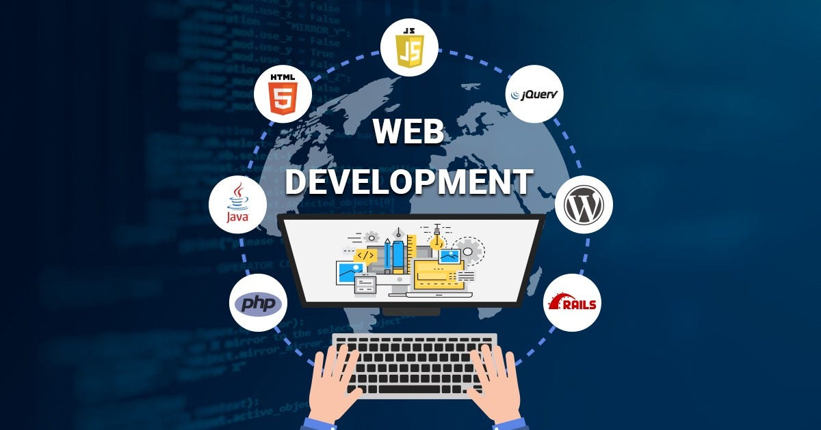
Introduction to Web Development
Web development refers to the creating, building, and maintaining of websites. It includes aspects such as web design, web publishing, web programming, and database management. It is the creation of an application that works over the internet i.e. websites..

Slide 7
Key Features
Web application development is a collaborative effort between front-end and back-end developers.
Web apps are less costly to develop than native apps, as they employ a single user interface and back-end systems for users across all platforms.
Web application development typically results in software with limitations in leveraging native features on the user's device.
There are two basic roles in web application development: front-end developer and back-end developer.

Slide 8

Scopes
Artificial Intelligence
Machine Learning
Data Analytics and Reporting
Voice-Enabled Interfaces
User Experience (UX) and User Interface (UI) design

Slide 9
Frontend and Backend
Front End Development :
The part of a website that the user interacts with directly is termed the front end. It includes everything that users experience directly: text colors and styles, images, graphs and tables, buttons, colors, and a navigation menu. HTML, CSS, and JavaScript are the languages used for Front End development.
Back End Development :
The backend is the server side of the website. It stores and arranges data, and also makes sure everything on the client side of the website works fine. It is part of the website that you cannot see and interact with. It is the portion of software that does not come in direct contact with the users.

Slide 10
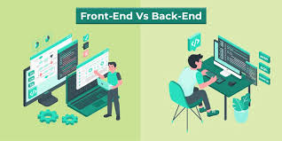
Front-End Vs Back-End

Slide 11
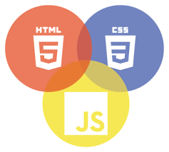
Technologies Used
1. Front-End technologies:
HTML (Hypertext Markup Language): Provides the structure and content of web pages.
CSS (Cascading Style Sheets): Styles the HTML elements, determining the layout and visual presentation.
JavaScript: Adds interactivity and dynamic behavior to the user interface. Frameworks like React, Angular, and Vue.js are commonly used for building complex UIs.

Slide 12


Technologies Used
2. Back-End technologies
Node.js (JavaScript): Used for server-side scripting. Node.js allows developers to use JavaScript on the server side to seamlessly create scalable and high-performance web applications.
Express.js: Express.js, or simply Express, is a back end web application framework for building RESTful APIs with Node.js, released as free and open-source software under the MIT License. It is designed for building web applications and API

Slide 13

Technologies Used
MongoDB:
MongoDB is a NoSQL database management application. NoSQL database systems offer an alternative to traditional relational databases using SQL (Structured Query Language). Data is stored in tables, rows, and columns in a relational database, with relationships between entities.

Slide 14
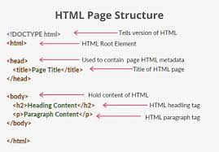
HTML
Basic Tags in HTML –
<DOCTYPE! html> – A doctype or document type declaration is an instruction that tells the web browser about the markup language in which the current page is written.
<html> – This tag is used to define the root element of HTML document. This tag tells the browser that it is an HTML document.
<head> – This tag is used to define the head portion of the HTML document that contains information related to the document
<body> – The body tag is used to enclose all the visible content of a webpage. In other words, the body content is what the browser will show on the front end.

Slide 15
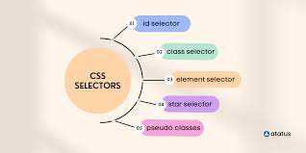
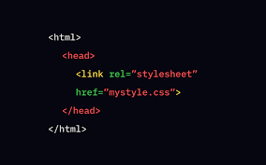
CSS
Styling is an essential property for any website. It increases the standards and overall look of the website that makes it easier for the user to interact with it. A website can be made without CSS, as styling is MUST since no user would want to interact with a dull and shabby website. So for knowing Web Development, learning CSS is mandatory.

Slide 16
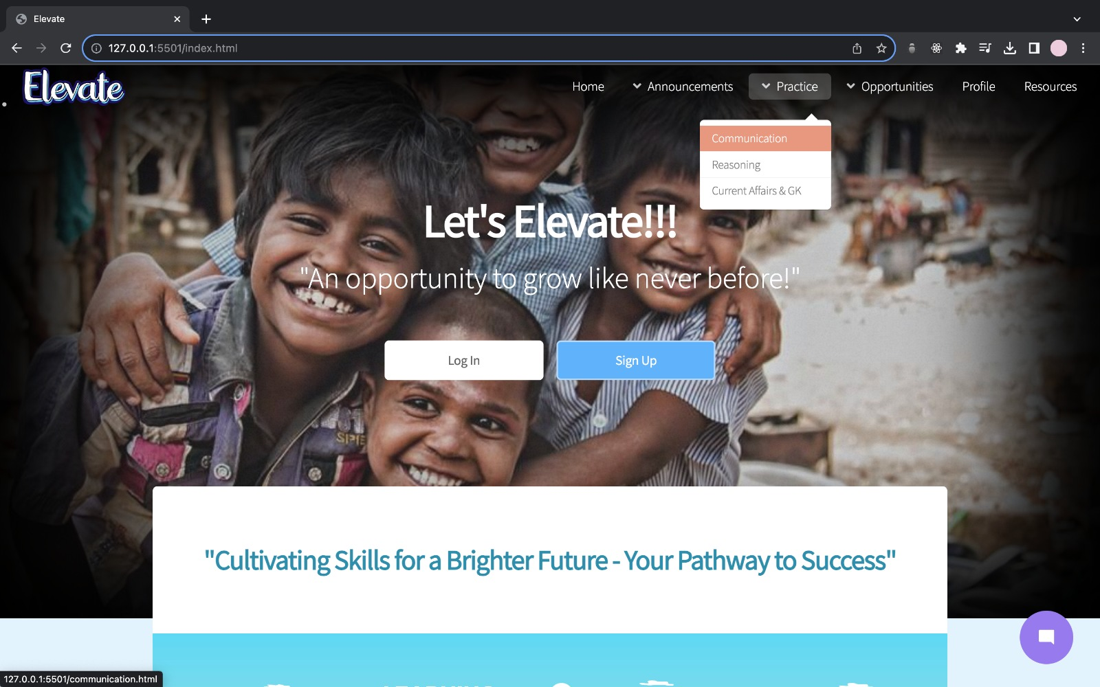
Introduction to Project
Elevate (Educational Website)

Slide 17
PROJECT DESCRIPTION
A solution to all the career related queries and problems.
A website which aims to bridge the gap between the downtrodden sections of the society and the educated class.
Providing quality education with minimum resources.

Slide 18
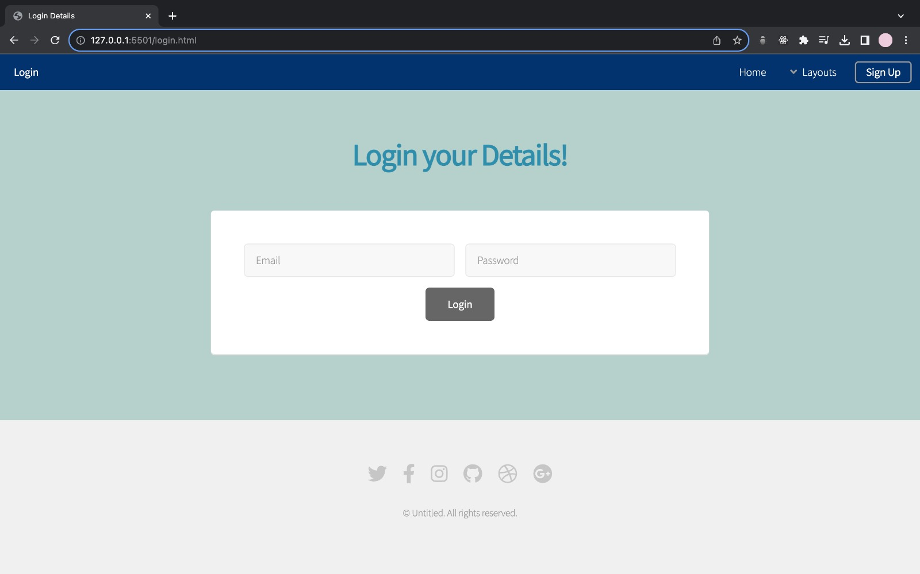
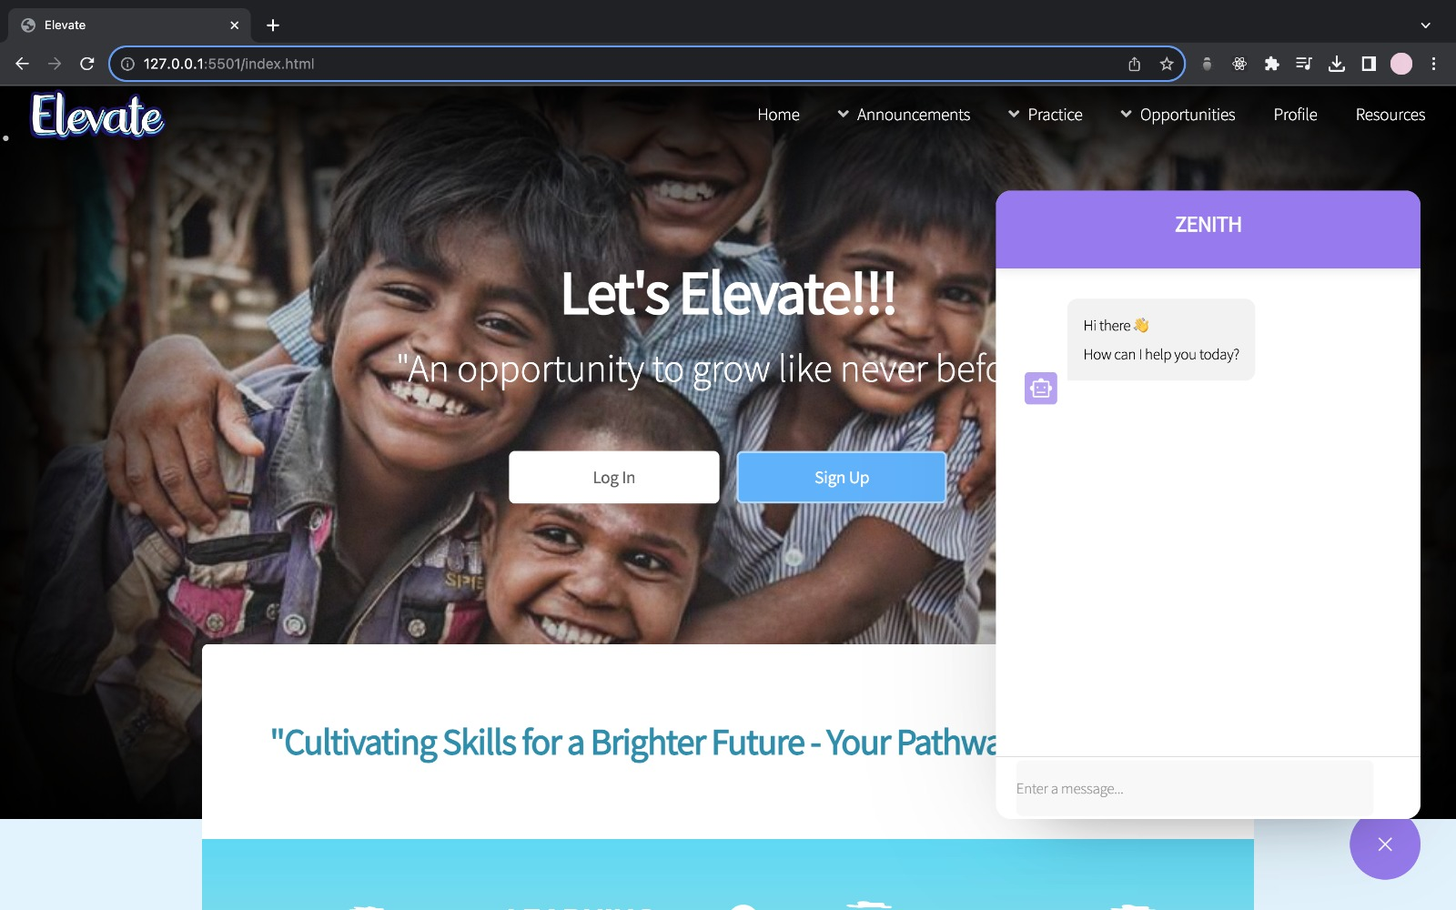
Screenshots of Website
Login Page
Chat Bot (Zenith)

Slide 19
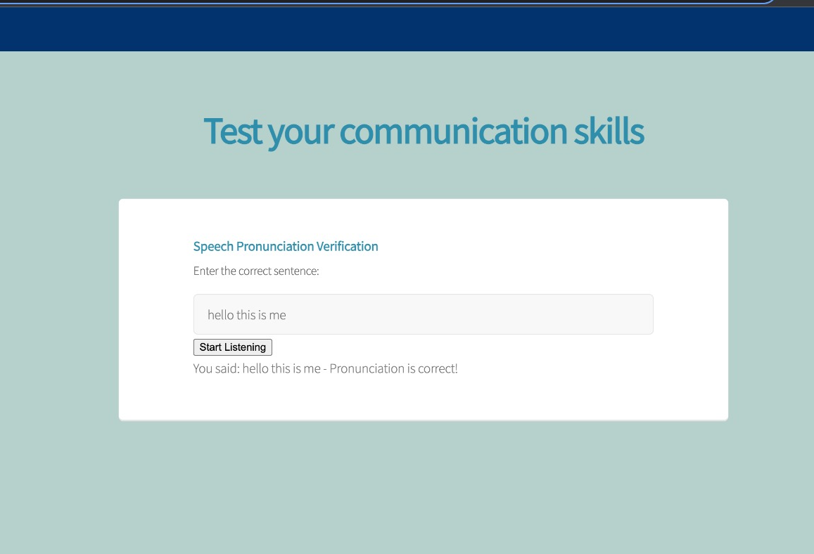
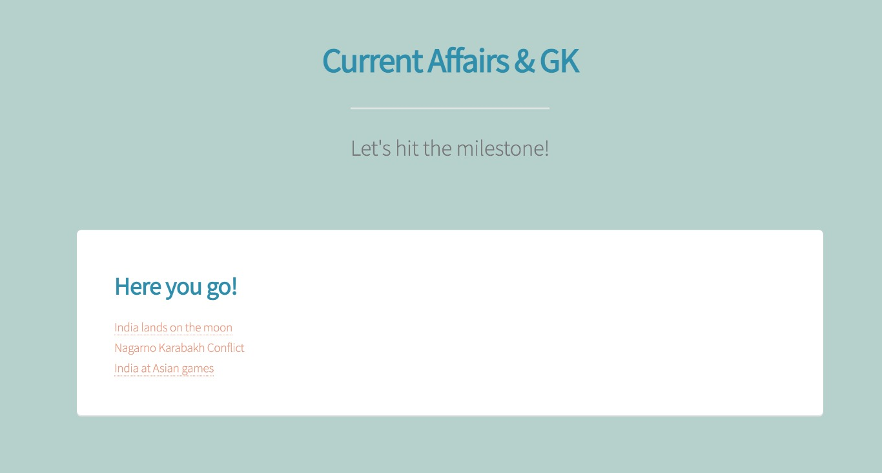
Pronunciation Testing
Current Affairs &
GK Page

Slide 20
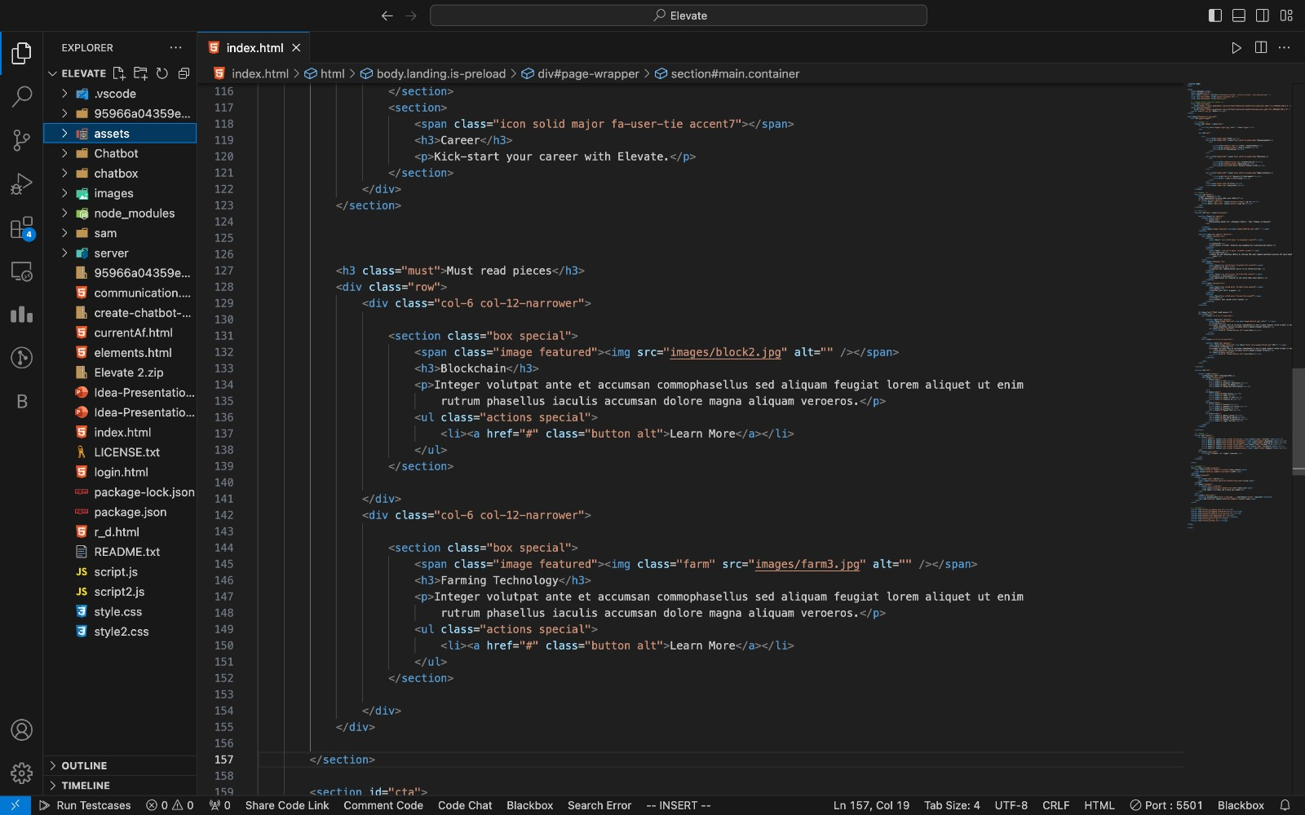
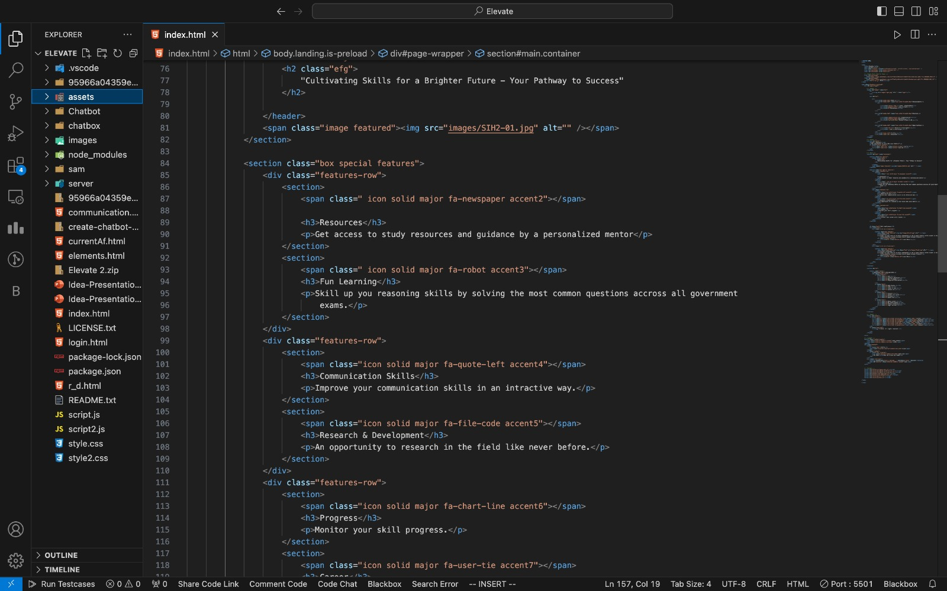

Slide 21
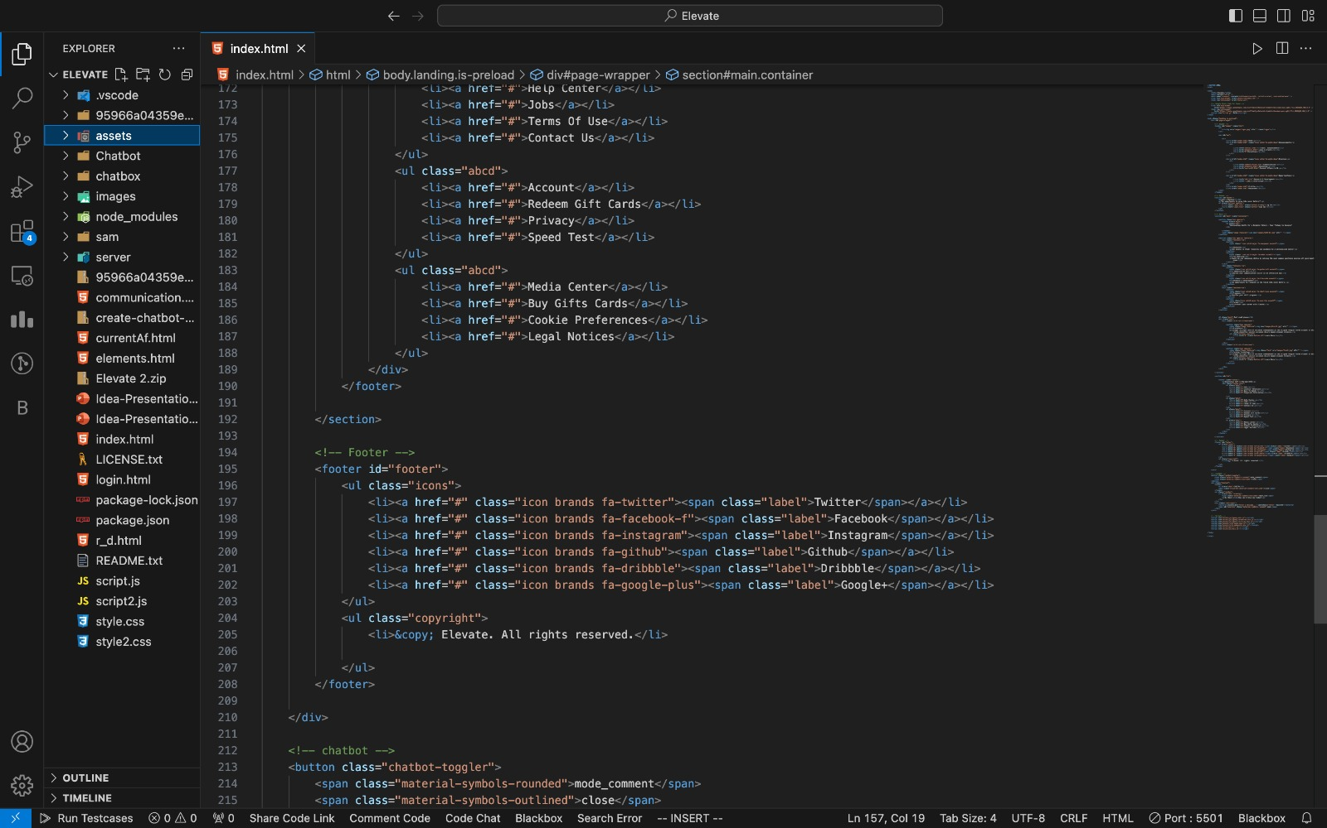
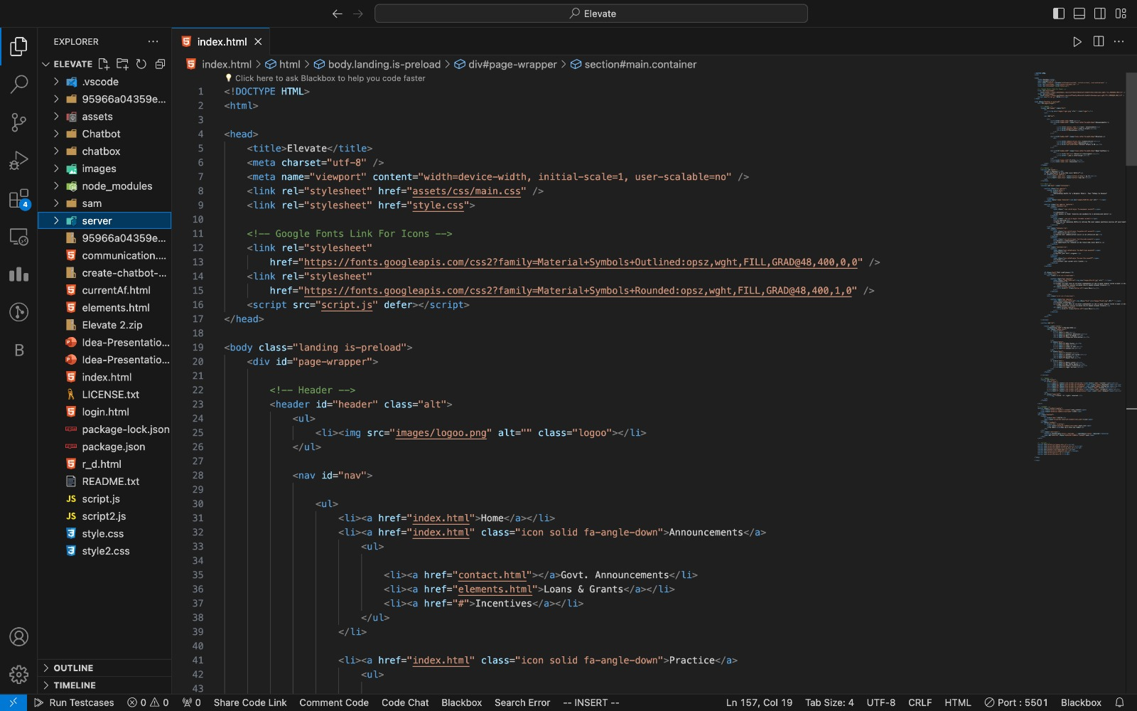

Slide 22
Web page details
Web Pages Details:
1. Resources: Access premium content in 22+ languages for free.
2. Practice: Test and strengthen your knowledge.
3. Profile: Track your progress effortlessly.
4. Announcements: Stay informed with vital updates.
5. Mentor: Receive personalized mentoring at no cost.
6. R&D: Share or seek research assistance.
7. Opportunities: Dive into a sea of possibilities.
8. Multilingual: Learn in 22+ languages, anytime, anywhere.

Slide 23
Future Scope Of Project
Affiliate Marketing: Partnering with relevant companies and earning a commission on products or services we promote.
Donations and Crowdfunding: Encourage donations from users who support our mission.
Grants and Sponsorships: Seek grants from organizations that align with our goals.
Partnerships: Collaborating with government agencies, NGOs, or private organizations that share our mission.
Sponsorships and Advertising: While being mindful of user experience, consider allowing relevant sponsors or advertisers to support our platform in exchange for exposure.
Corporate Social Responsibility (CSR) Partnerships: Partner with companies with CSR programs to support skill development and employment opportunities for underserved communities.
Continuous Impact Assessment: Regularly measure and showcase the social impact of our platform to attract funding and partnerships from organizations focused on social responsibility.

Slide 24
References
▪ For Content:
▪ www.w3schools.com
▪ www.programiz.com
▪ www.javascript.com
▪ www.getbootstrap.com

Slide 25
THANK YOU

